Slide 1


Day 23
Math24 (Differential Equations)
Ch 4.4 The Method of Variation of Parameters; Higher Order (Page 241-247)
Elementary Differential Equations and Boundary Value Problems, 10th edition, by William E. Boyce and Richard C. DiPrima, ©2013 by John Wiley & Sons, Inc.

Slide 2
The variation of parameters method can be used to find a particular solution of the nonhomogeneous nth order linear differential equation
provided g is continuous.
As with 2nd order equations, begin by assuming y₁, y₂ …, y_{n} are fundamental solutions to homogeneous equation.
Next, assume the particular solution Y has the form
where u₁, u₂,… u_{n} are functions to be solved for.
In order to find these n functions, we need n equations.

Slide 3


Variation of Parameters Derivation (2 of 5)
First, consider the derivatives of Y:
If we require
then
Thus we next require
Continuing in this way, we require
and hence

Slide 4

Variation of Parameters Derivation (3 of 5)
From the previous slide,
Finally,
Next, substitute these derivatives into our equation
Recalling that y₁, y₂ …, y_{n} are solutions to homogeneous equation, and after rearranging terms, we obtain

Slide 5
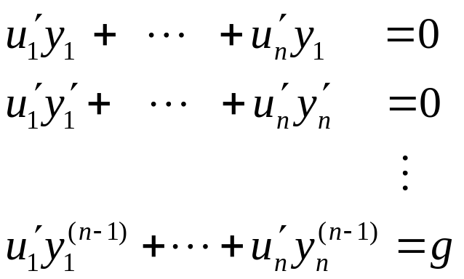
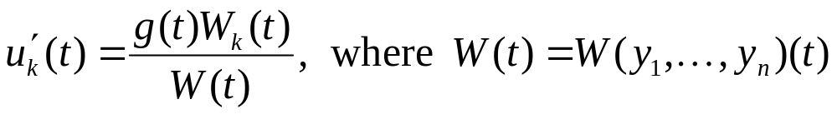
Variation of Parameters Derivation (4 of 5)
The n equations needed in order to find the n functions u₁, u₂,… u_{n} are
Using Cramer’s Rule, for each k = 1, …, n,
and W_{k} is determinant obtained by replacing k th column of W with (0, 0, …, 1).

Slide 6
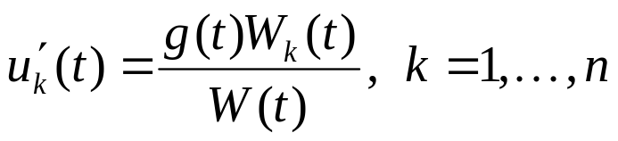
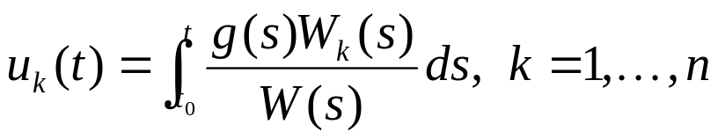
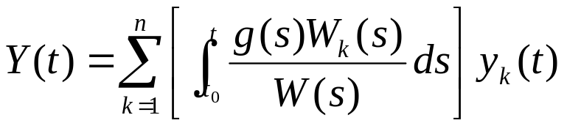
Variation of Parameters Derivation (5 of 5)
From the previous slide,
Integrate to obtain u₁, u₂,… u_{n}:
Thus, a particular solution Y is given by
where t₀ is arbitrary.

Slide 7
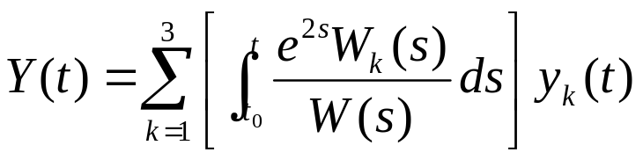
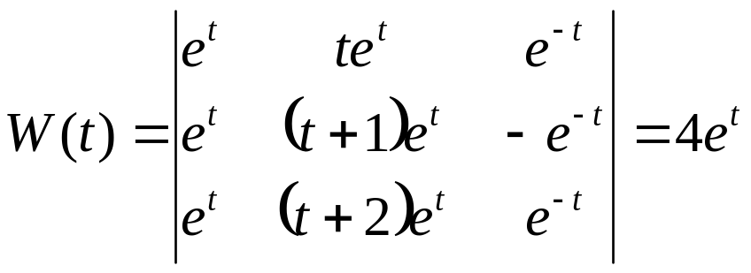
Example 1 (1 of 3)
Consider the equation below, along with the given solutions of corresponding homogeneous solutions y₁, y₂, y₃:
Then a particular solution of this ODE is given by
It can be shown that

Slide 8
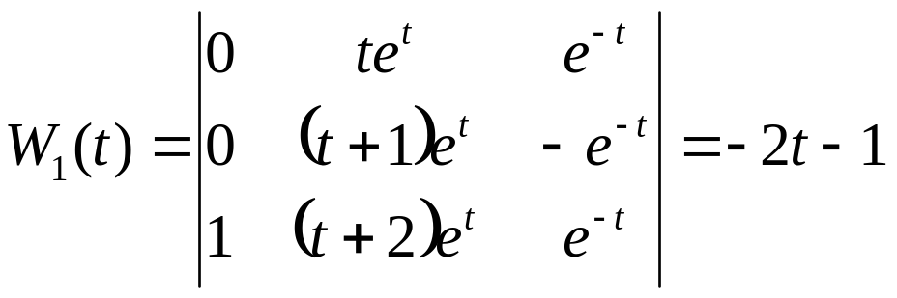
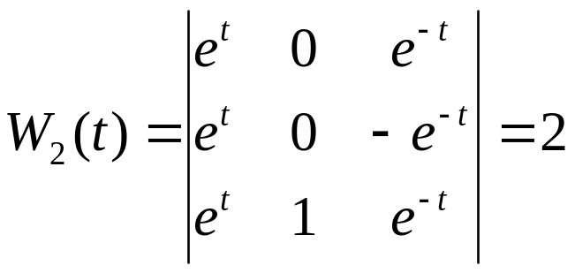
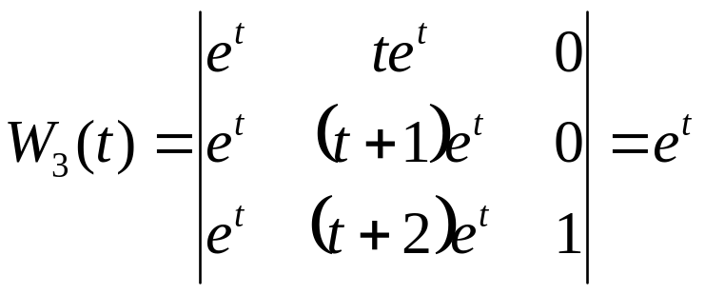
Example 1 (2 of 3)
Also,

Slide 9

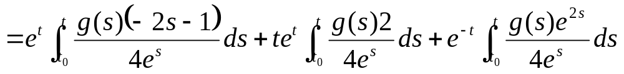
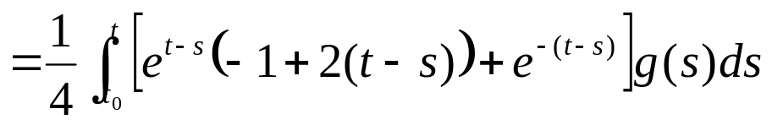
Example 1 (3 of 3)
Thus a particular solution in integral form is

